Slide 1

Facility Reservations
Click to Begin

Slide 2
Error!
Please follow the on-screen
instructions to continue.
Go Back

Slide 3
Complete
Please navigate to the next module
in the course to continue.
Restart Course

Slide 4
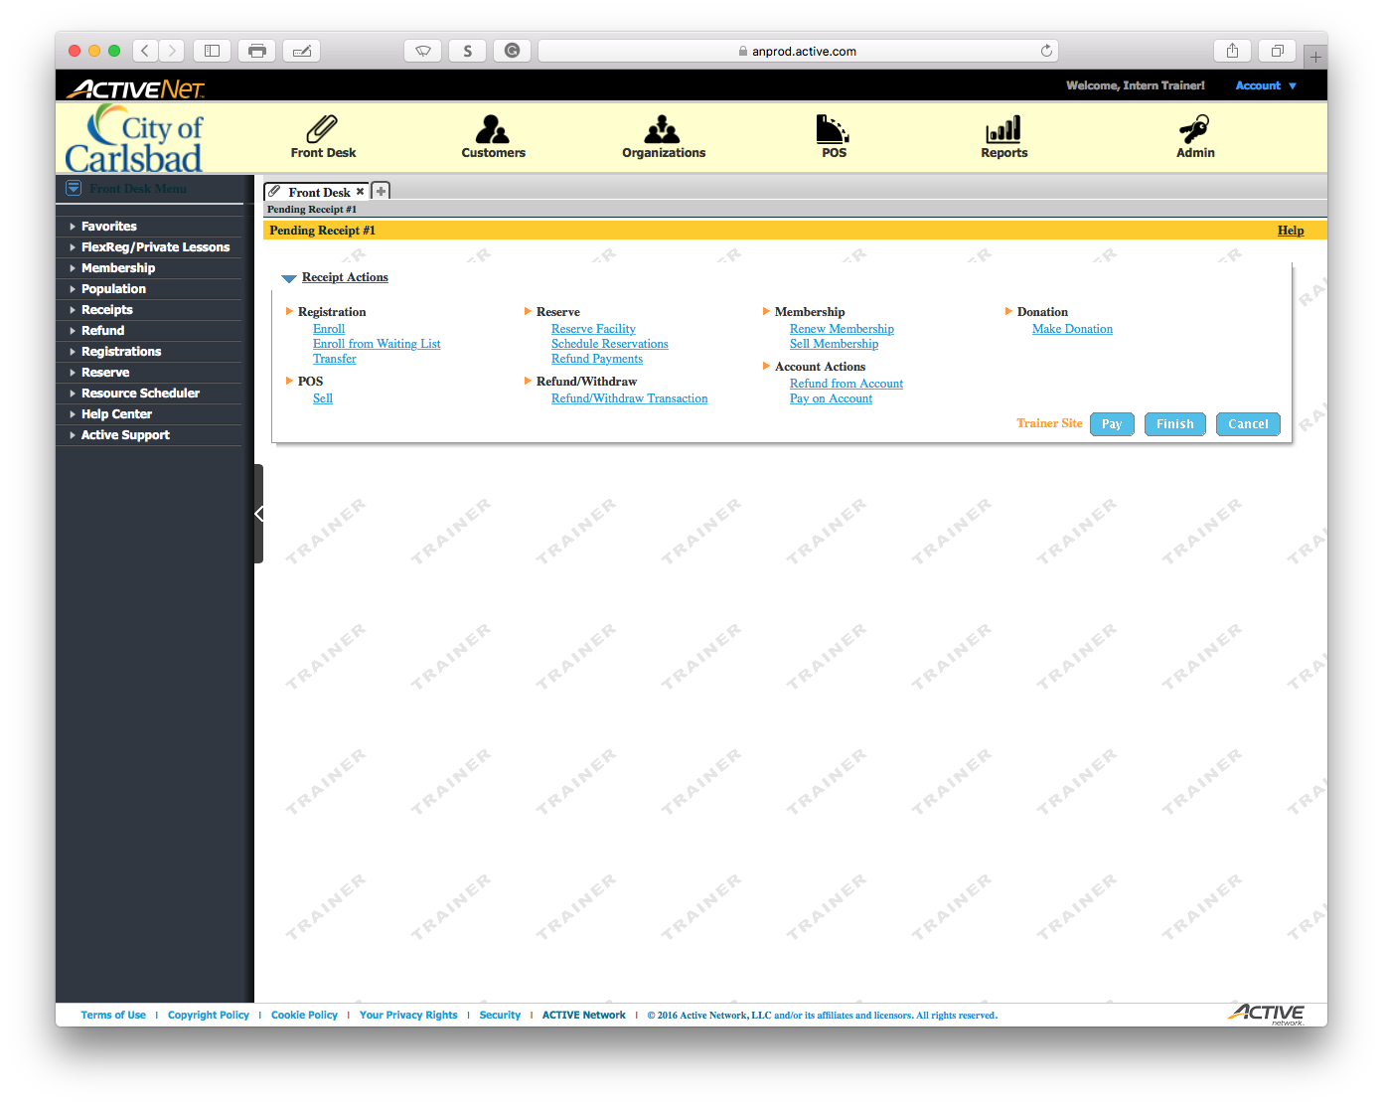
Tip:
Main Text Instruction Will Go Here
The Master Title Text will go here.
Sub Instruction Here
Subtext here.

Slide 5
Error!
Please follow the on-screen
instructions to continue.
Go Back

Slide 6
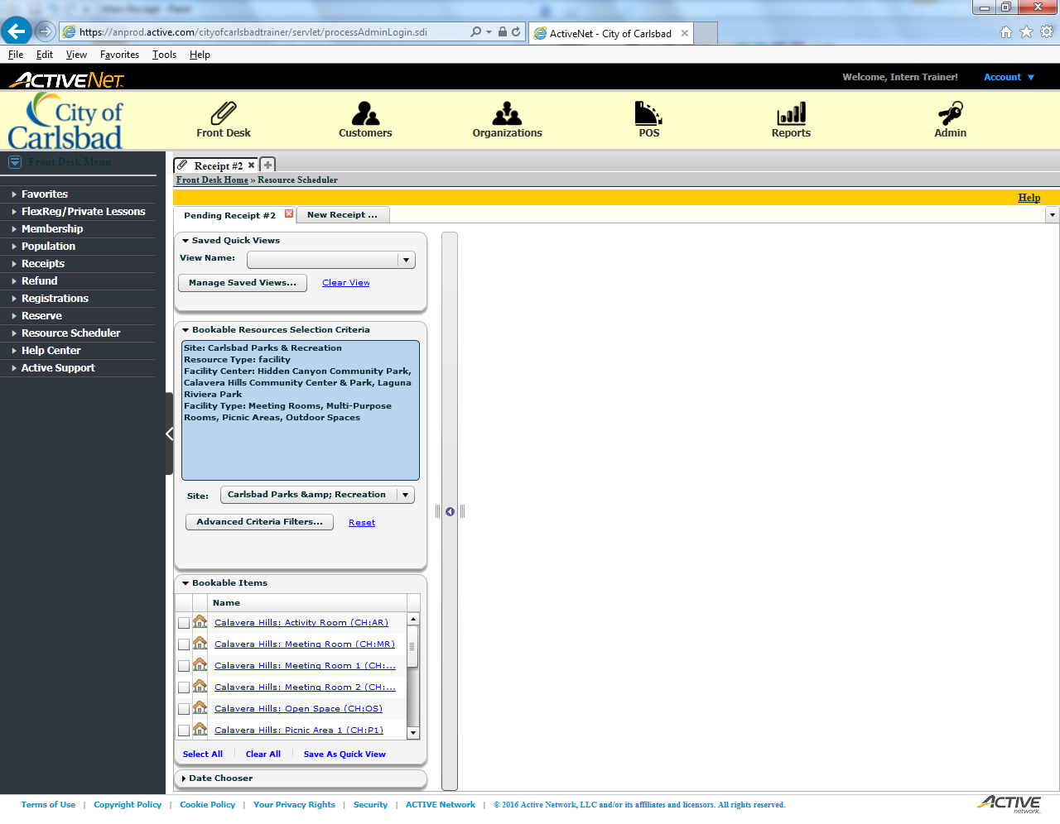
Tip:
The Master Title Text will go here.
Main Text Instruction Will Go Here
Sub Instruction Here
Subtext here.

Slide 7
Error!
Please follow the on-screen
instructions to continue.
Go Back

Slide 8
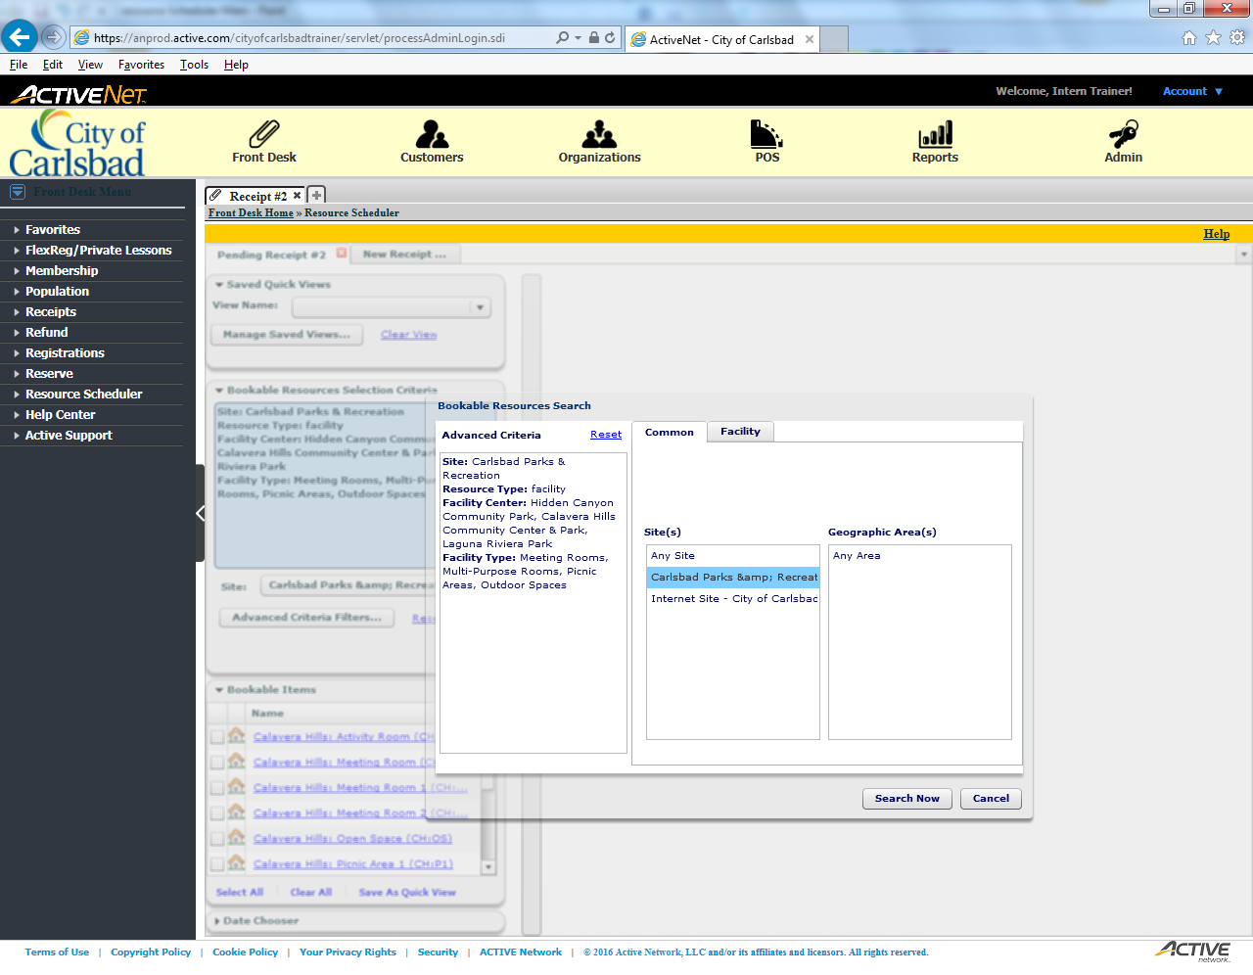
Tip:
The Master Title Text will go here.
Main Text Instruction Will Go Here

Slide 9
Error!
Please follow the on-screen
instructions to continue.
Go Back

Slide 10
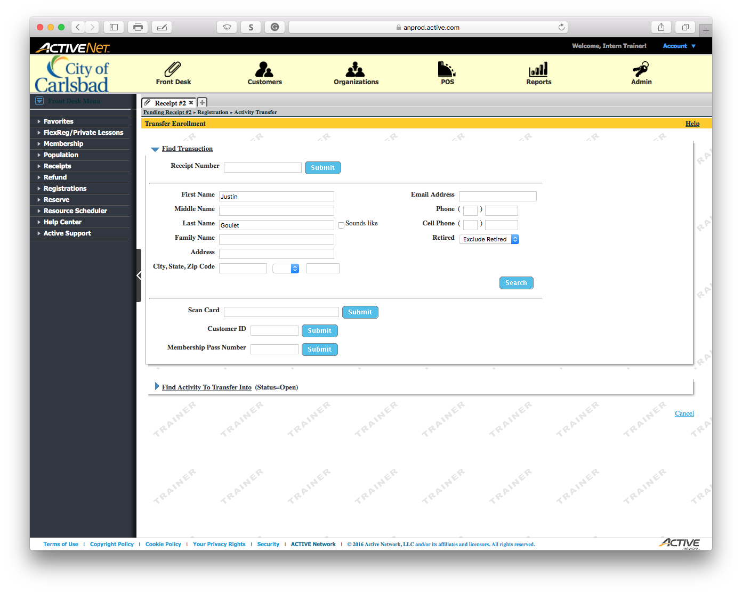
Tip:
Main Text Instruction Will Go Here
The Master Title Text will go here.
Sub Instruction Here
Subtext here.

Slide 11
Error!
Please follow the on-screen
instructions to continue.
Go Back

Slide 12
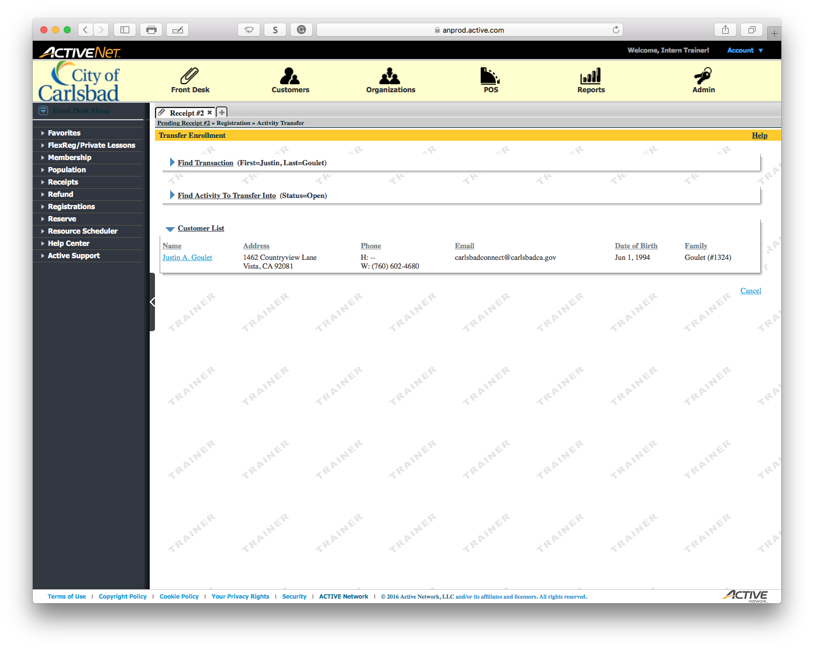
Tip:
Main Text Instruction Will Go Here
The Master Title Text will go here.
Sub Instruction Here
Subtext here.

Slide 13
Error!
Please follow the on-screen
instructions to continue.
Go Back

Slide 14
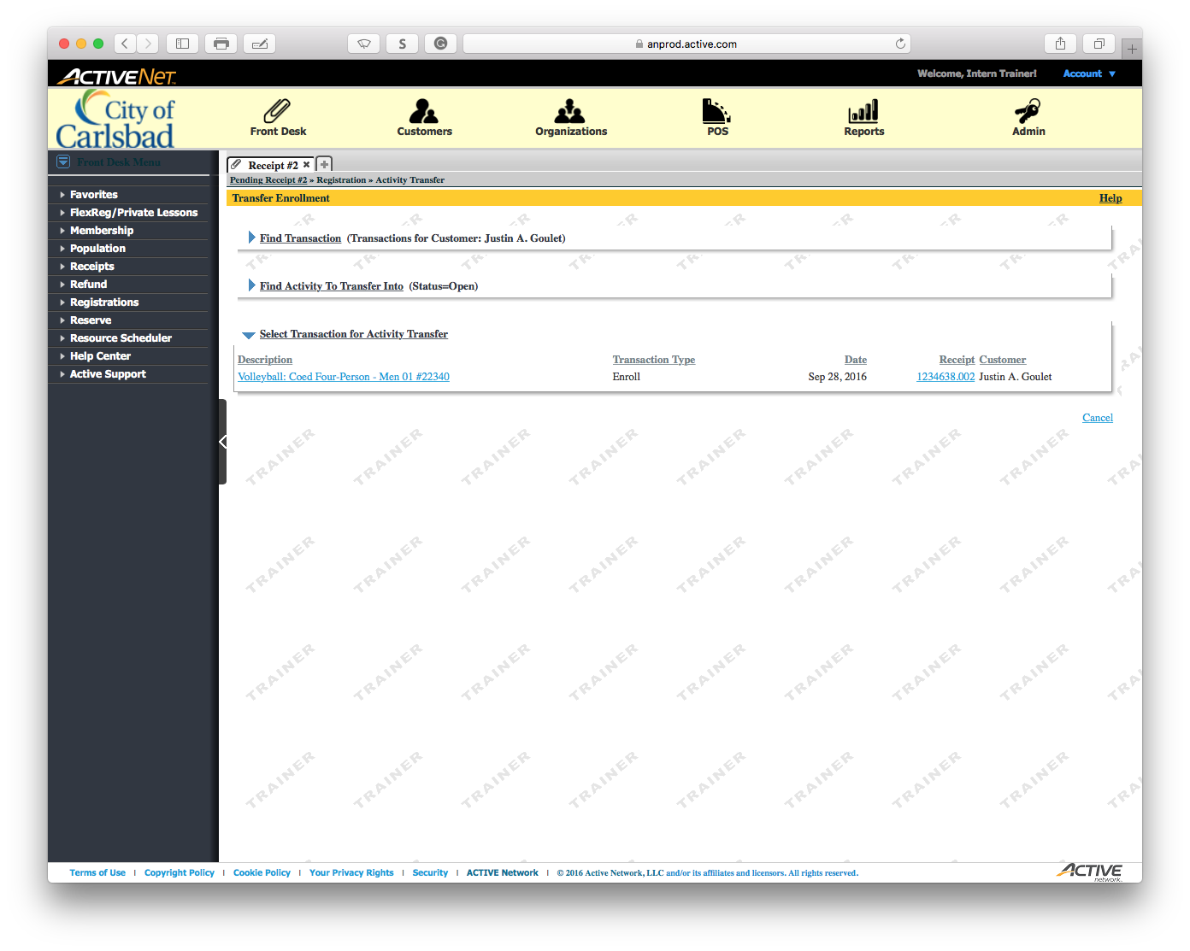
Tip:
Main Text Instruction Will Go Here
The Master Title Text will go here.
Sub Instruction Here
Subtext here.

Slide 15
Error!
Please follow the on-screen
instructions to continue.
Go Back

Slide 16
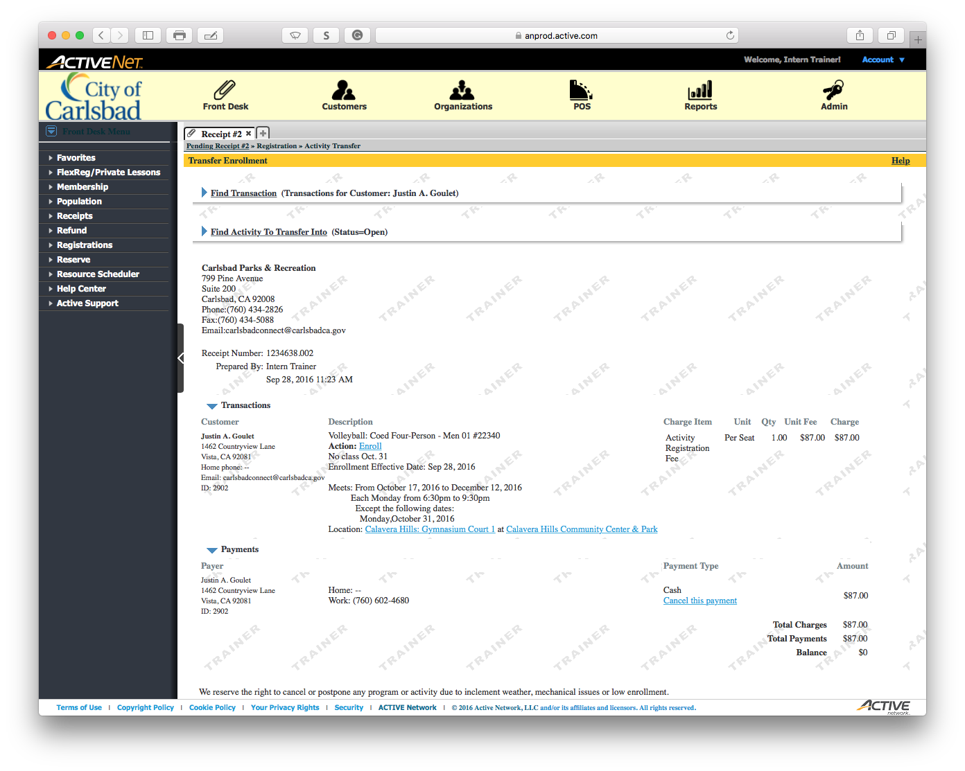
Tip:
Main Text Instruction Will Go Here
The Master Title Text will go here.
Sub Instruction Here
Subtext here.

Slide 17
Error!
Please follow the on-screen
instructions to continue.
Go Back

Slide 18
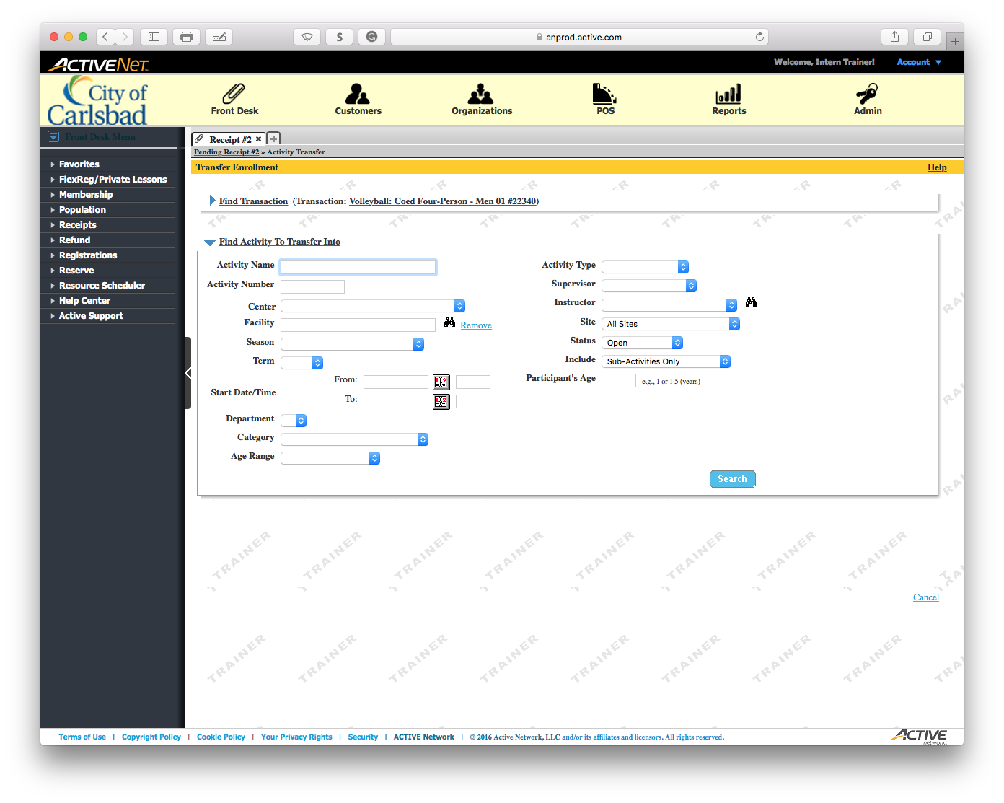
Tip:
Main Text Instruction Will Go Here
The Master Title Text will go here.
Sub Instruction Here
Subtext here.

Slide 19

Tip:
Main Text Instruction Will Go Here
The Master Title Text will go here.
Sub Instruction Here
Subtext here.

Slide 20
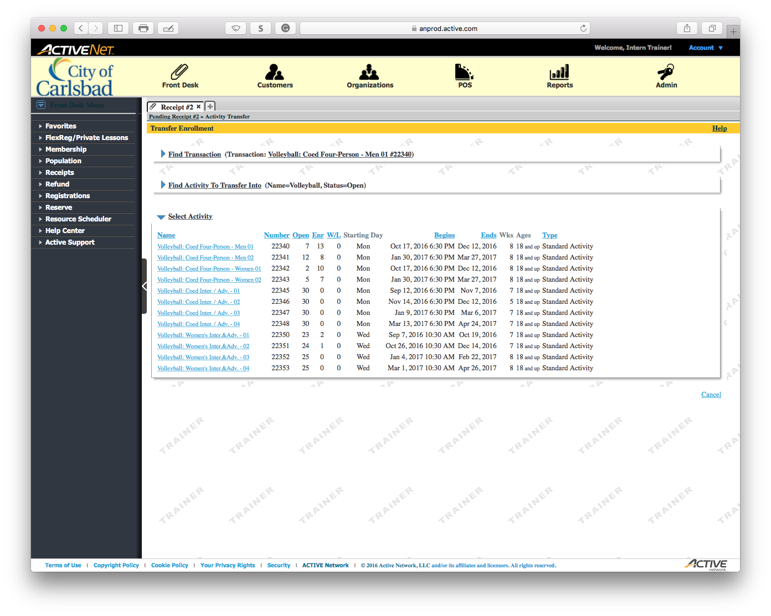
Tip:
Main Text Instruction Will Go Here
The Master Title Text will go here.
Sub Instruction Here
Subtext here.

Slide 21
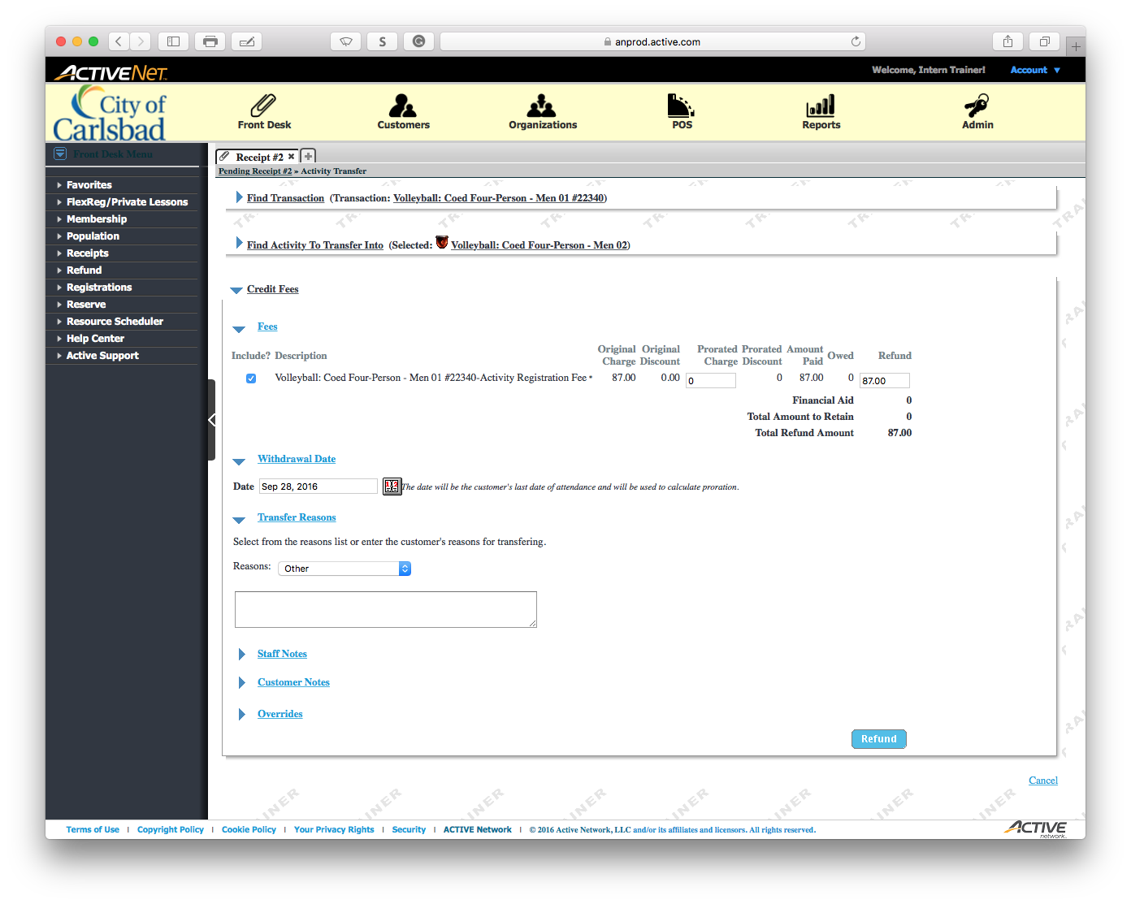
Tip:
Main Text Instruction Will Go Here
The Master Title Text will go here.
Sub Instruction Here
Subtext here.

Slide 22
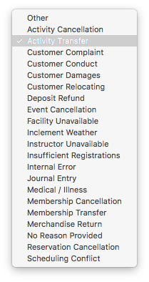
Tip:
Main Text Instruction Will Go Here
The Master Title Text will go here.
Sub Instruction Here
Subtext here.

Slide 23
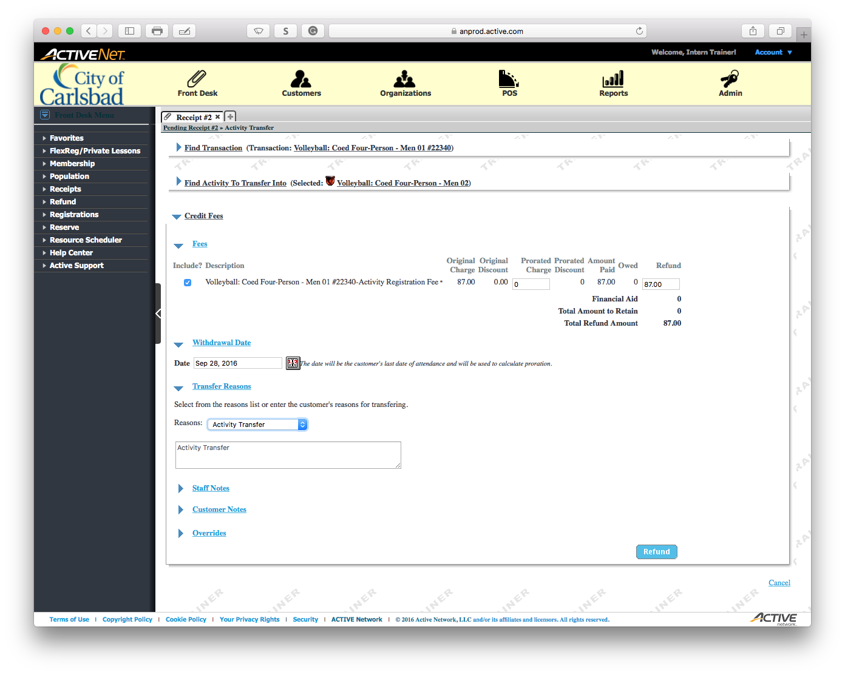
Tip:
Main Text Instruction Will Go Here
The Master Title Text will go here.
Sub Instruction Here
Subtext here.

Slide 24
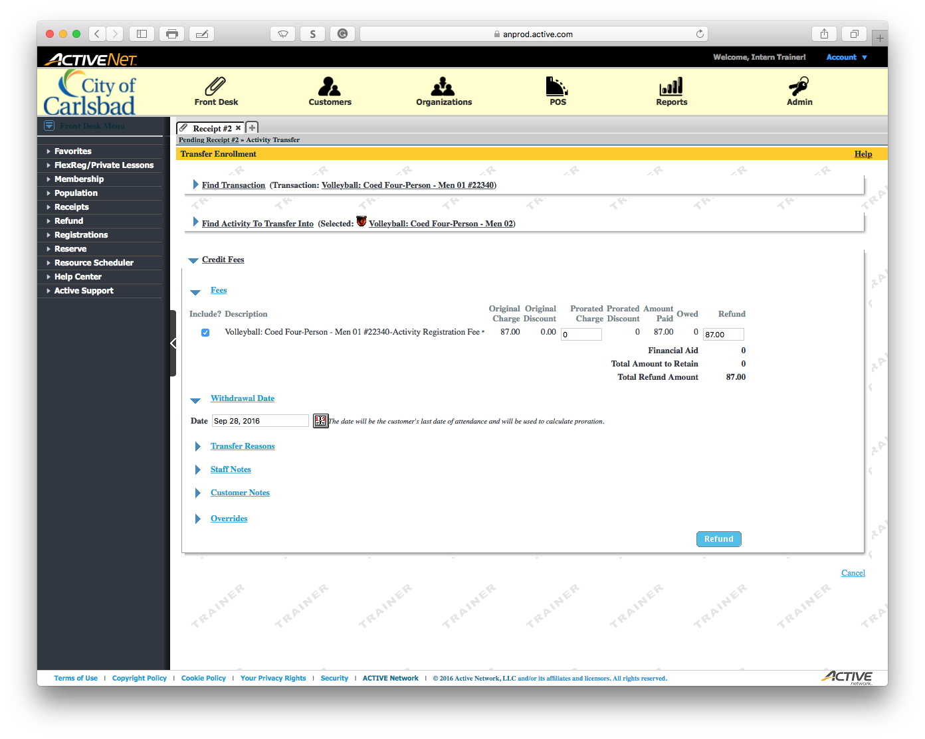
Tip:
Main Text Instruction Will Go Here
The Master Title Text will go here.
Sub Instruction Here
Subtext here.

Slide 25
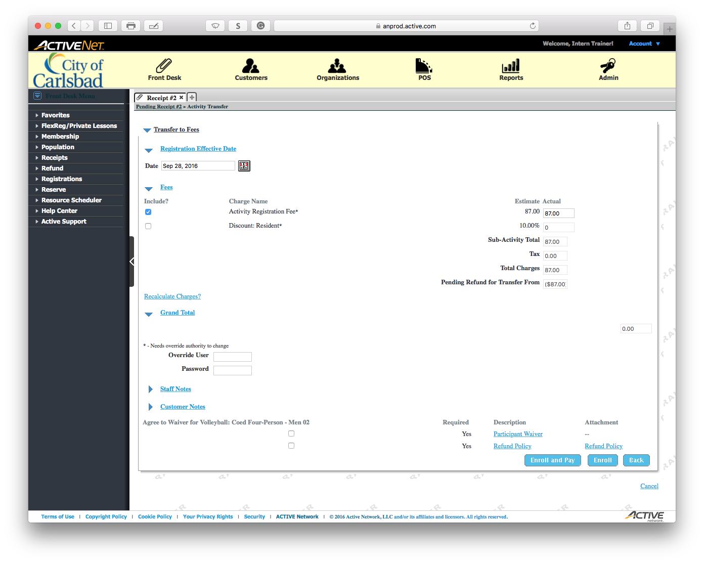
Tip:
Main Text Instruction Will Go Here
The Master Title Text will go here.
Sub Instruction Here
Subtext here.

Slide 26

Tip:
Main Text Instruction Will Go Here
The Master Title Text will go here.
Sub Instruction Here
Subtext here.

Slide 27

Tip:
Main Text Instruction Will Go Here
The Master Title Text will go here.
Sub Instruction Here
Subtext here.

Slide 28
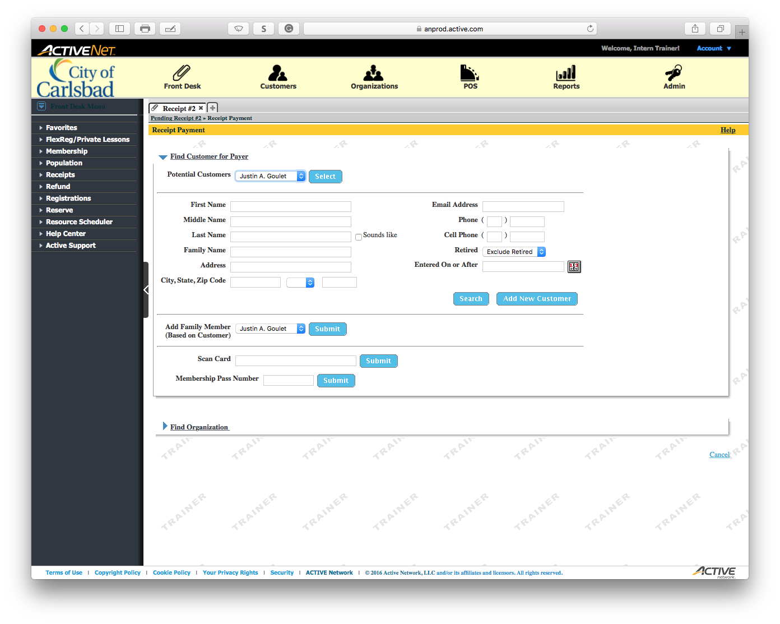
Tip:
Main Text Instruction Will Go Here
The Master Title Text will go here.
Sub Instruction Here
Subtext here.

Slide 29
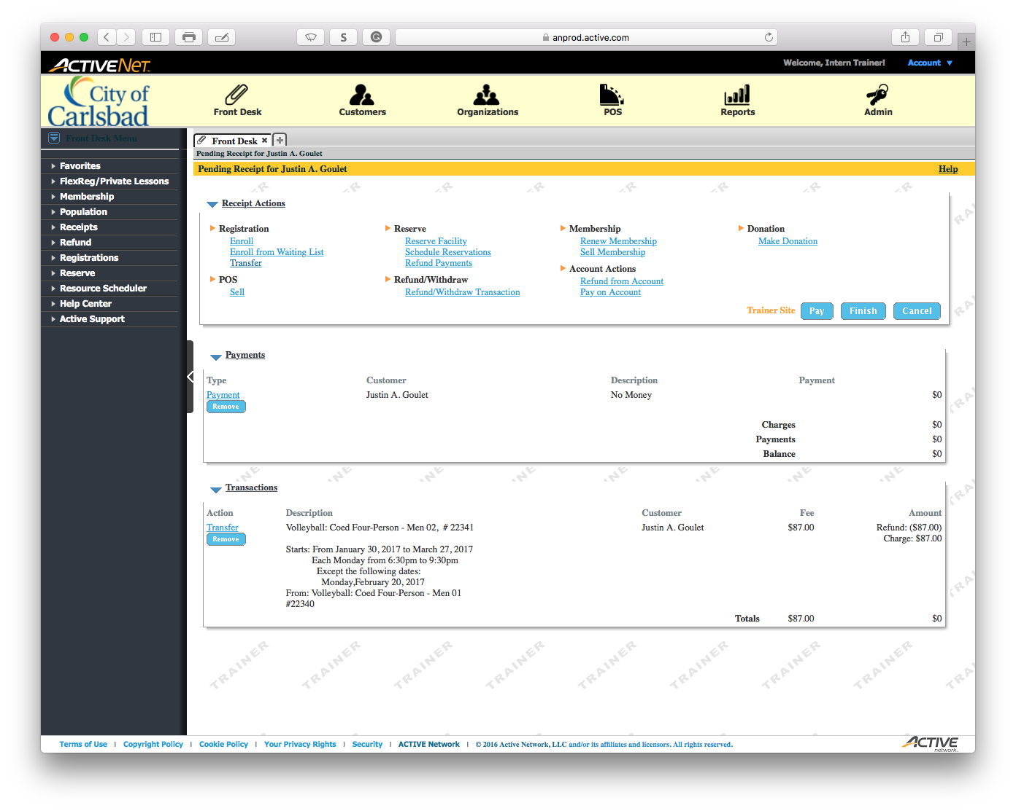
Tip:
Main Text Instruction Will Go Here
The Master Title Text will go here.
Sub Instruction Here
Subtext here.

Slide 30
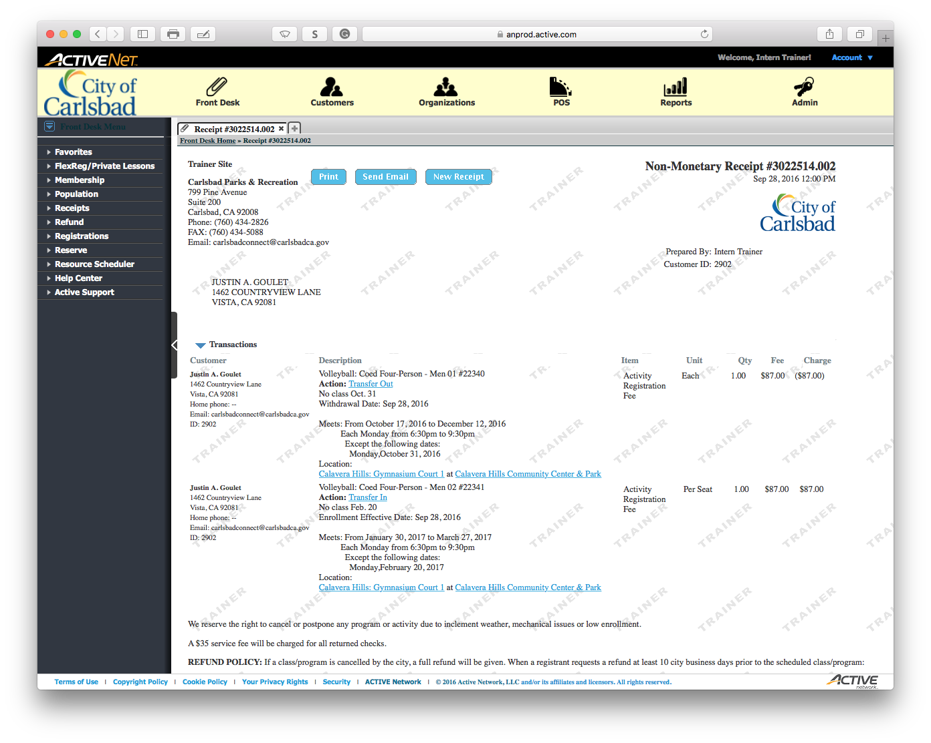
Tip:
Main Text Instruction Will Go Here
The Master Title Text will go here.
Sub Instruction Here
Subtext here.

Slide 31
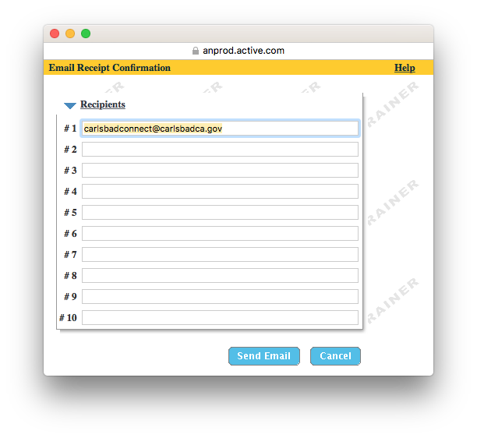
Tip:
Main Text Instruction Will Go Here
The Master Title Text will go here.
Sub Instruction Here
Subtext here.

